Slide 1
Section 1.4 Solving Quadratic Equations
Lecture 1
Three Methods for Quadratic Equations

Slide 2
Section 1.4 Homework Submission to Canvas
Preview of section
Skim the section in text and write a short paragraph summary.
Give a bulleted list of all important definitions, theorems, and formulas without details.
Notes on video lectures
Take notes on everything written on slides including all details, worked examples, on-own activities, as well as your own thoughts and questions.
Try on-own activities first, then write down provided solution next to it for comparison.
Worked examples from the text
Write down the problem and attempt without looking at the solution.
Use the solution to write the best explanation you can.
Solutions to textbook exercises
Model approaches and explanations given in the video lectures and textbook examples.
Final reflection of section
List the key takeaways to remember as a bulleted list.

Slide 3
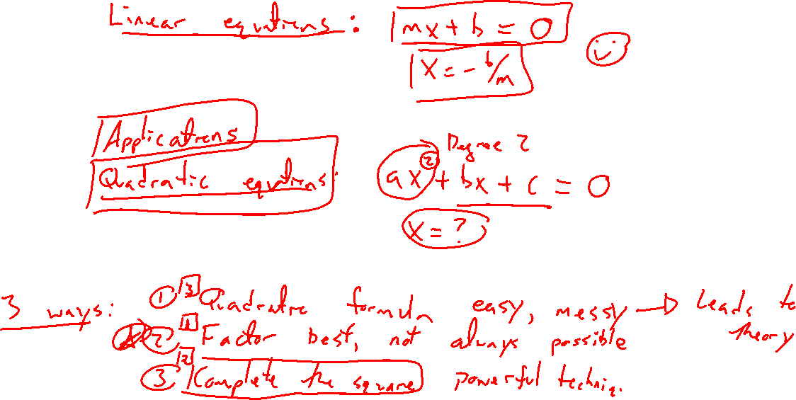
Equation Solving
Notes:
Linear: mx + b = 0, m \neq 0 (easy to solve)
Quadratic: ax^2 + bx + c = 0, a \neq 0 (much harder / richer)
- shows up in naturally many places: geometry, physics, optics, optimization, finance
- here we just focus on solving equations, graphs in Chapter 2-3

Slide 4
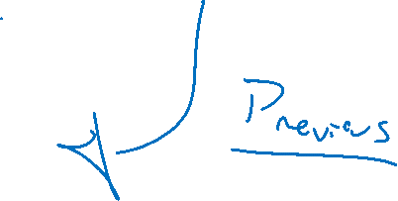
Three Methods
Notes:
Ax^2+bx+c=0
Factor (always easiest, not always possible, need zero on one side)
Complete the square (general technique shows up other places)
Quadratic formula (memorize, tedius, can always use, need zero on one side)

Slide 5
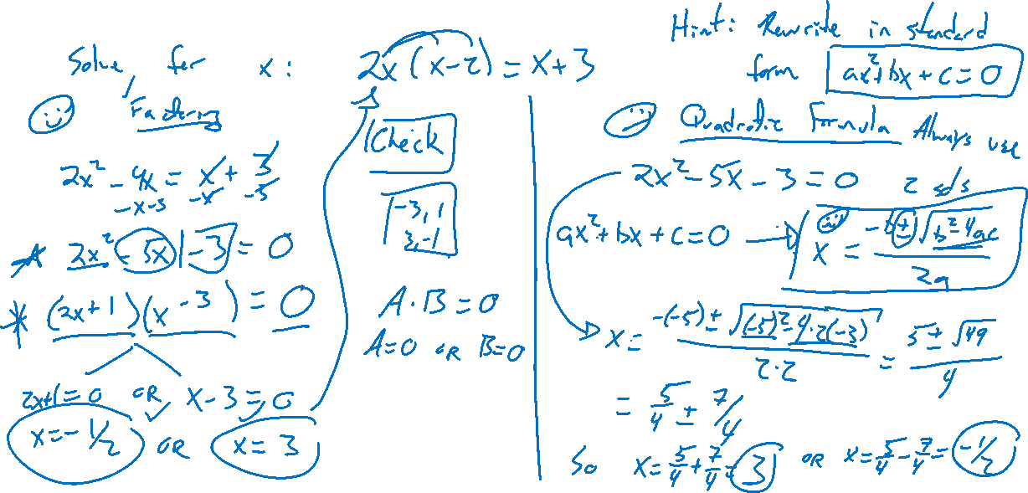
Example: Try on Own
Notes:
Solve for x: 2x(x-2) = x+3
2 ways, factoring and quadratic formula
Check solutions work
Note why factoring separates into two equations ONLY if one side is zero
Note factoring not always possible

Slide 6
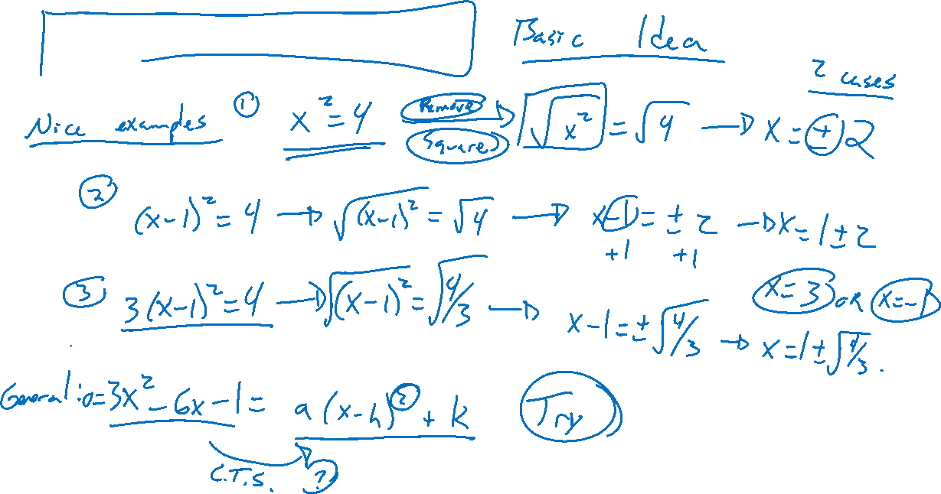
Completing the Square
Notes:
Nice examples: x^2 = 4, (x-1)^2 = 4, 3(x-1)^2=4, not the +- for two solutions
What if not in this form?
3x^2-6x-1=0, complete the square , technique in next section

